Slide 1

#30DayChartChallenge: Nicola's Experience
May 26, 2022
8:00 pm - 10:00 pm (GMT +3)

Slide 2
Agenda
Time | Activity | Speaker/ Moderator
8:00 pm – 8:05 pm | Participants joining | Njoki Njuki
8:05 pm – 8:15 pm | Welcoming remarks and introducing the speaker | Njoki Njuki
8:15 pm – 9:15 pm | Talk | Dr. Nicola Rennie
9:15 pm – 9:45 pm | Q & A | Shel Kariuki
9:45pm – 9:50 pm | Closing remarks | Shel Kariuki

Slide 3
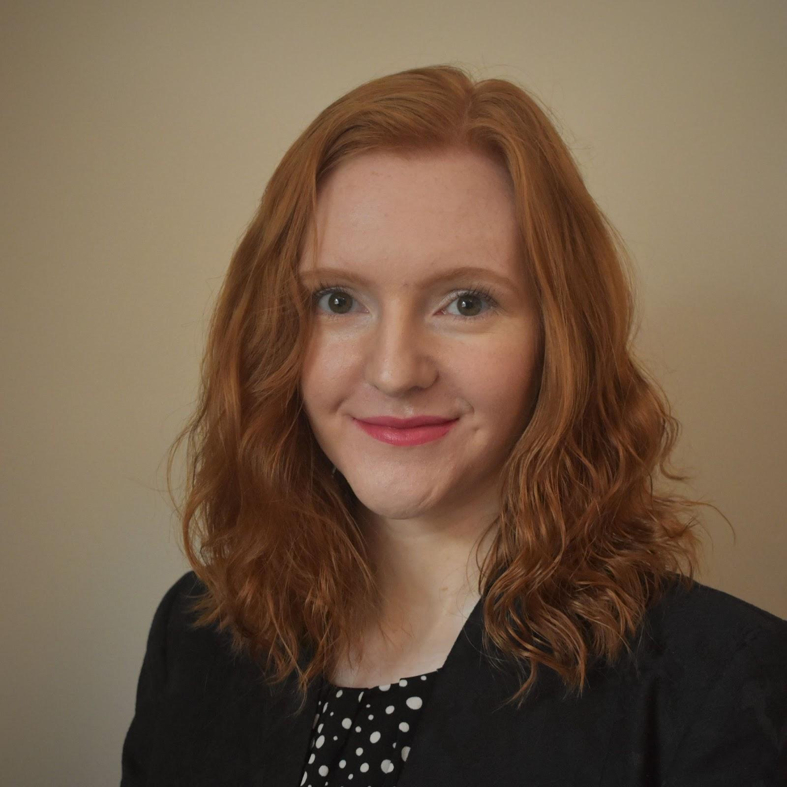
Our Speaker
Dr. Nicola Rennie
Statistician and Data Scientist, Jumping Rivers

Slide 4
Talk Session

Slide 5
Q & A

Slide 6


Slide 7
THANK YOU!!
Email address: nairobi@rladies.org
LinkedIn: @R-Ladies Nairobi
Twitter: @RLadiesNairobi
Meetup: https://www.meetup.com/rladies-nairobi/

